Slide 1
Regression, Prediction and Classification
Jacob LaRiviere
(some content from Justin Rao)

Slide 2
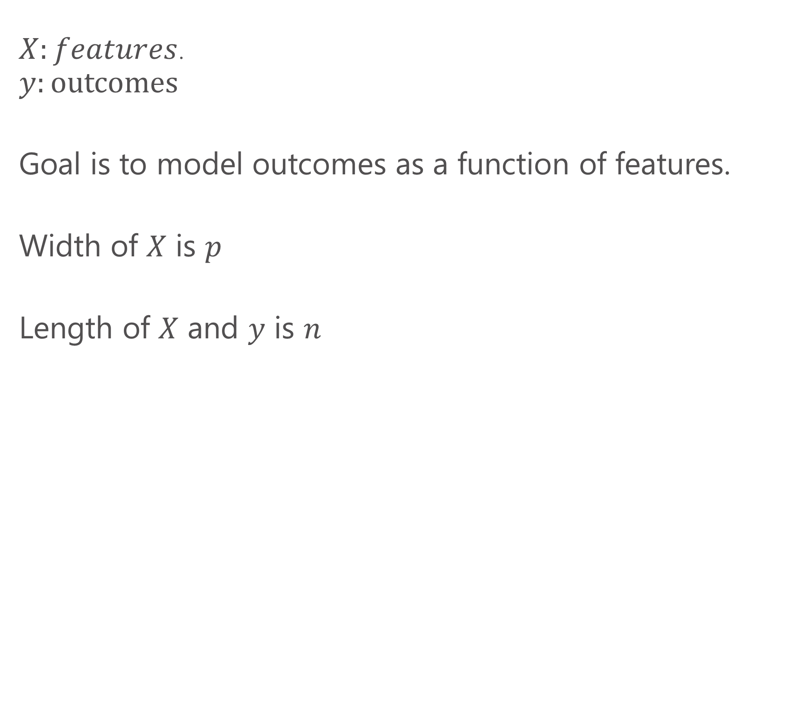
Terminology
$X:features$.
$$y:\text{outcomes}$$
Goal is to model outcomes as a function of features.
Width of $X$ is $p$
Length of $X$ and $y$ is $n$

Slide 3
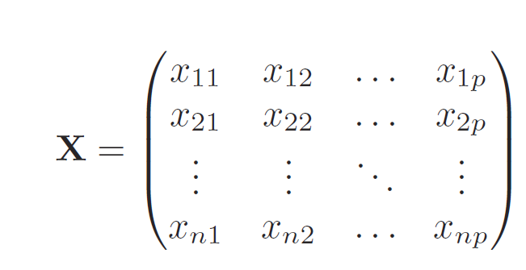
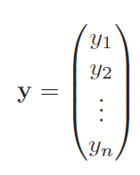
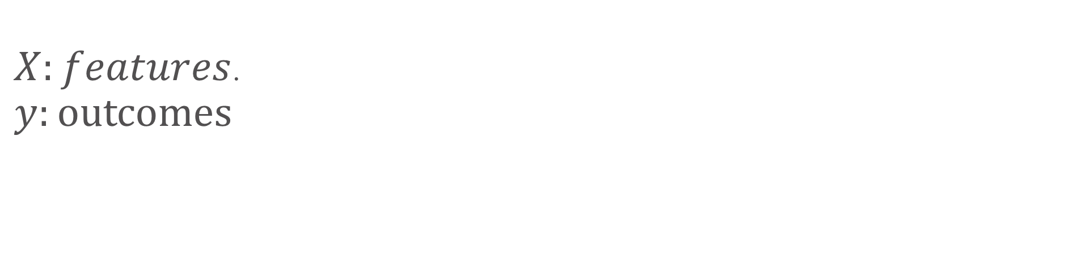
Terminology cont.
$X:features$.
$$y:\text{outcomes}$$
Feature 1
Obs 1
Obs 1

Slide 4
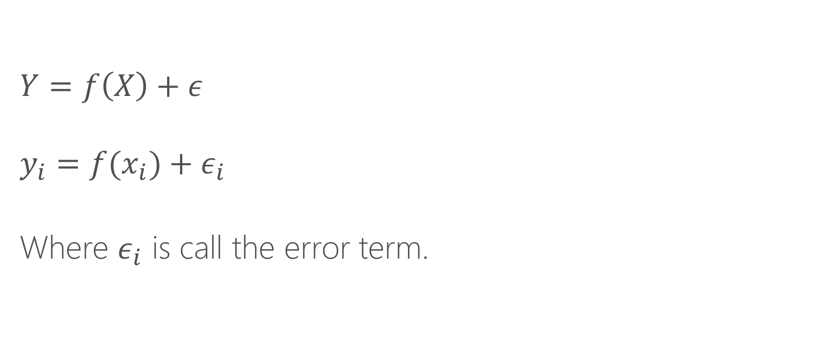
Estimating equations
$$Y=f\left(X\right)+ε$$
$$y_{i}=f(x_{i})+ε_{i}$$
Where $ε_{i}$ is call the error term.

Slide 5
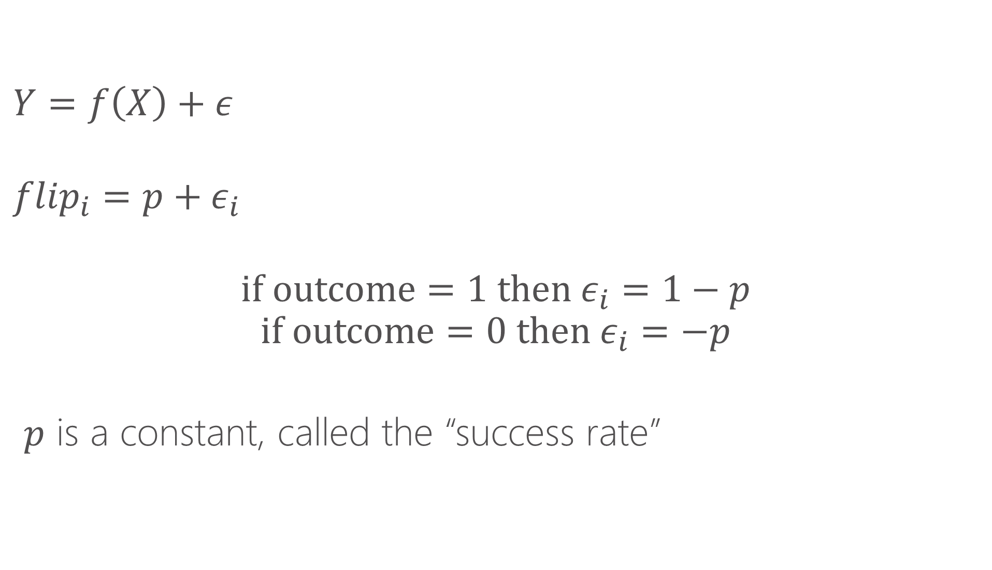
Example: coin flipping
$$Y=f\left(X\right)+ε$$
$${flip}_{i}=p+ε_{i}$$
$$if outcome=1 then ε_{i}=1−p$$
$$if outcome=0 then ε_{i}=−p$$
$p$ is a constant, called the “success rate”

Slide 6
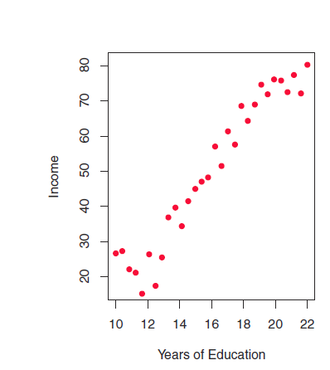
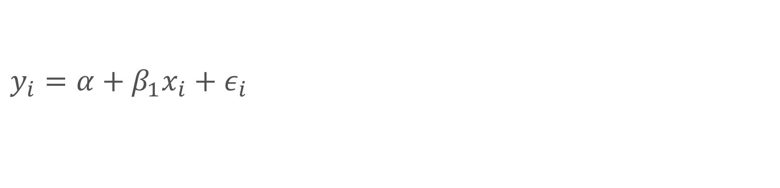
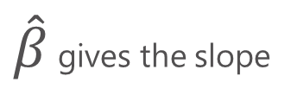
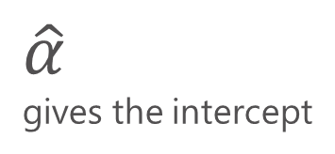
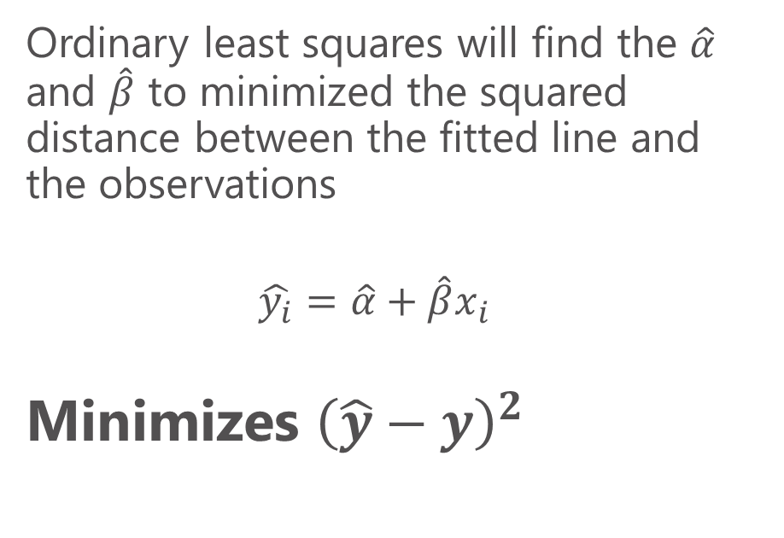
Linear regression
$\hat{β}$ gives the slope
$$y_{i}=α+β_{1}x_{i}{+ ε}_{i}$$
Ordinary least squares will find the $\hat{α}$ and $\hat{β}$ to minimized the squared distance between the fitted line and the observations
$$\hat{y_{i}}=\hat{α}+{\hat{β}x}_{i}$$
Minimizes ${\left(\hat{y}−y\right)}^{2}$
$\hat{α}$
gives the intercept

Slide 7
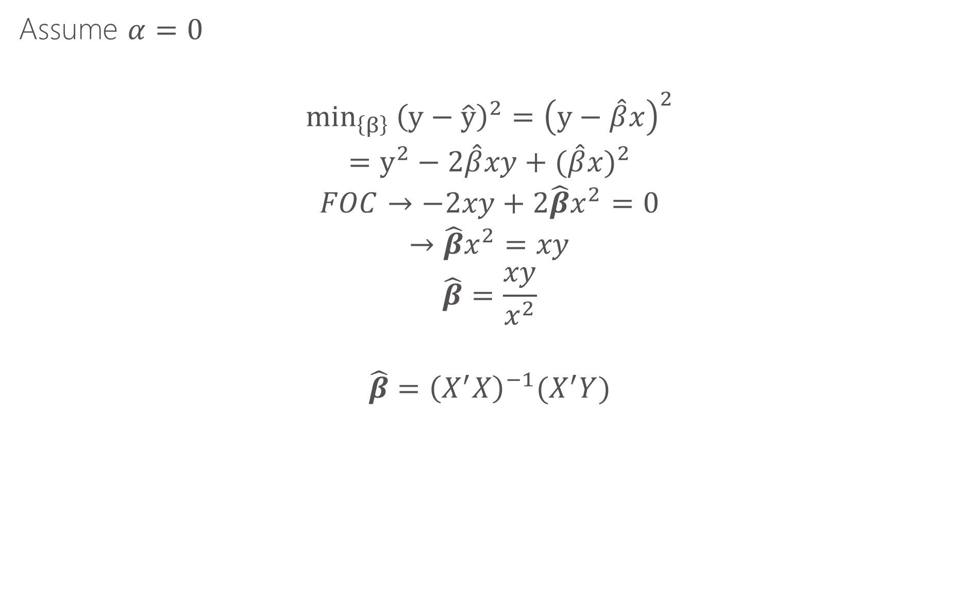
How does this work intuitively?
Assume $α=0$
$${min_{\left\{β\right\}} \left(y−\hat{y}\right)}^{2}={\left(y−\hat{β}x\right)}^{2}$$
$$=y^{2}−2\hat{β}xy+{(\hat{β}x)}^{2}$$
$$FOC→−2xy+{2\hat{β}x}^{2}=0$$
$$→{\hat{β}x}^{2}=xy$$
$$\hat{β}=\frac{xy}{x^{2}}$$
$$\hat{β}={\left(X^{′}X\right)}^{−1}(X^{′}Y)$$

Slide 8
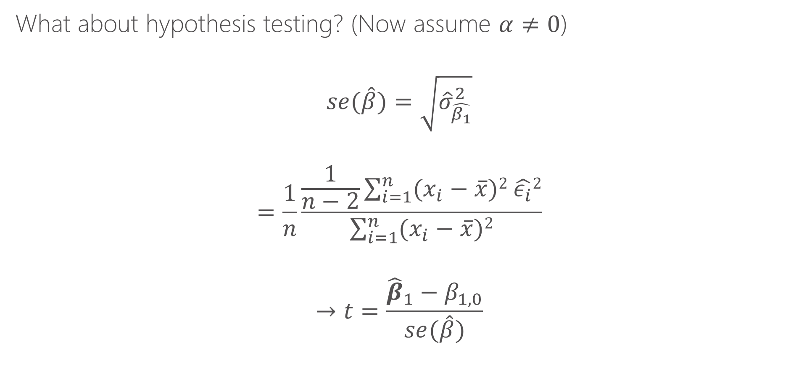
How does this work for inference?
What about hypothesis testing? (Now assume $α≠0$)
$$se(\hat{β})=\sqrt{{\hat{σ}}_{\hat{β_{1}}}^{2}}$$
$$=\frac{1}{n}\frac{\frac{1}{n−2}\sum_{i=1}^{n}{(x_{i}−\overline{x}})2 \hat{ε_{i}}2}{\sum_{i=1}^{n}{(x_{i}−\overline{x}})2}$$
$$→t=\frac{{\hat{β}}_{1}−β_{1,0}}{se(\hat{β})}$$
Both of these are themselves sample statistics from from data y and X. As a result, they both have their own distributions (e.g., normal and Chi Squared). The results ration has the Student t distribution which is used for hypothesis testing for a given sample.

Slide 9
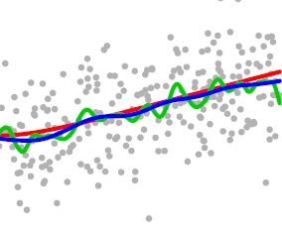
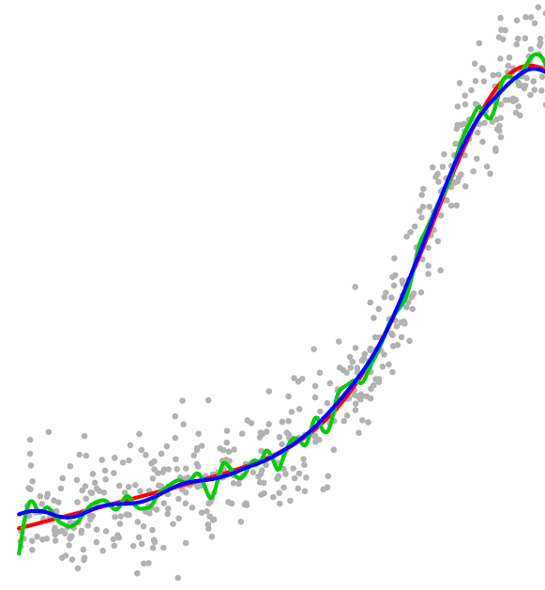
Height as function of age
Growth is most rapid in ages 12-16
AGE

Slide 10
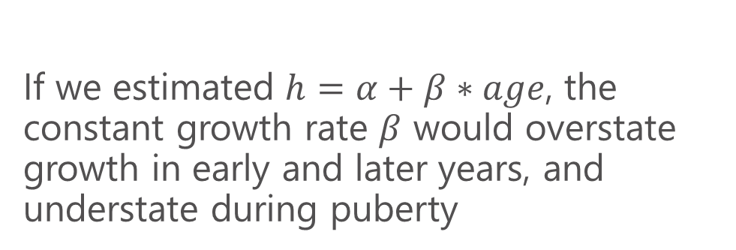
Height as function of age
If we estimated $h=α+β∗age$, the constant growth rate $β$ would overstate growth in early and later years, and understate during puberty
AGE

Slide 11
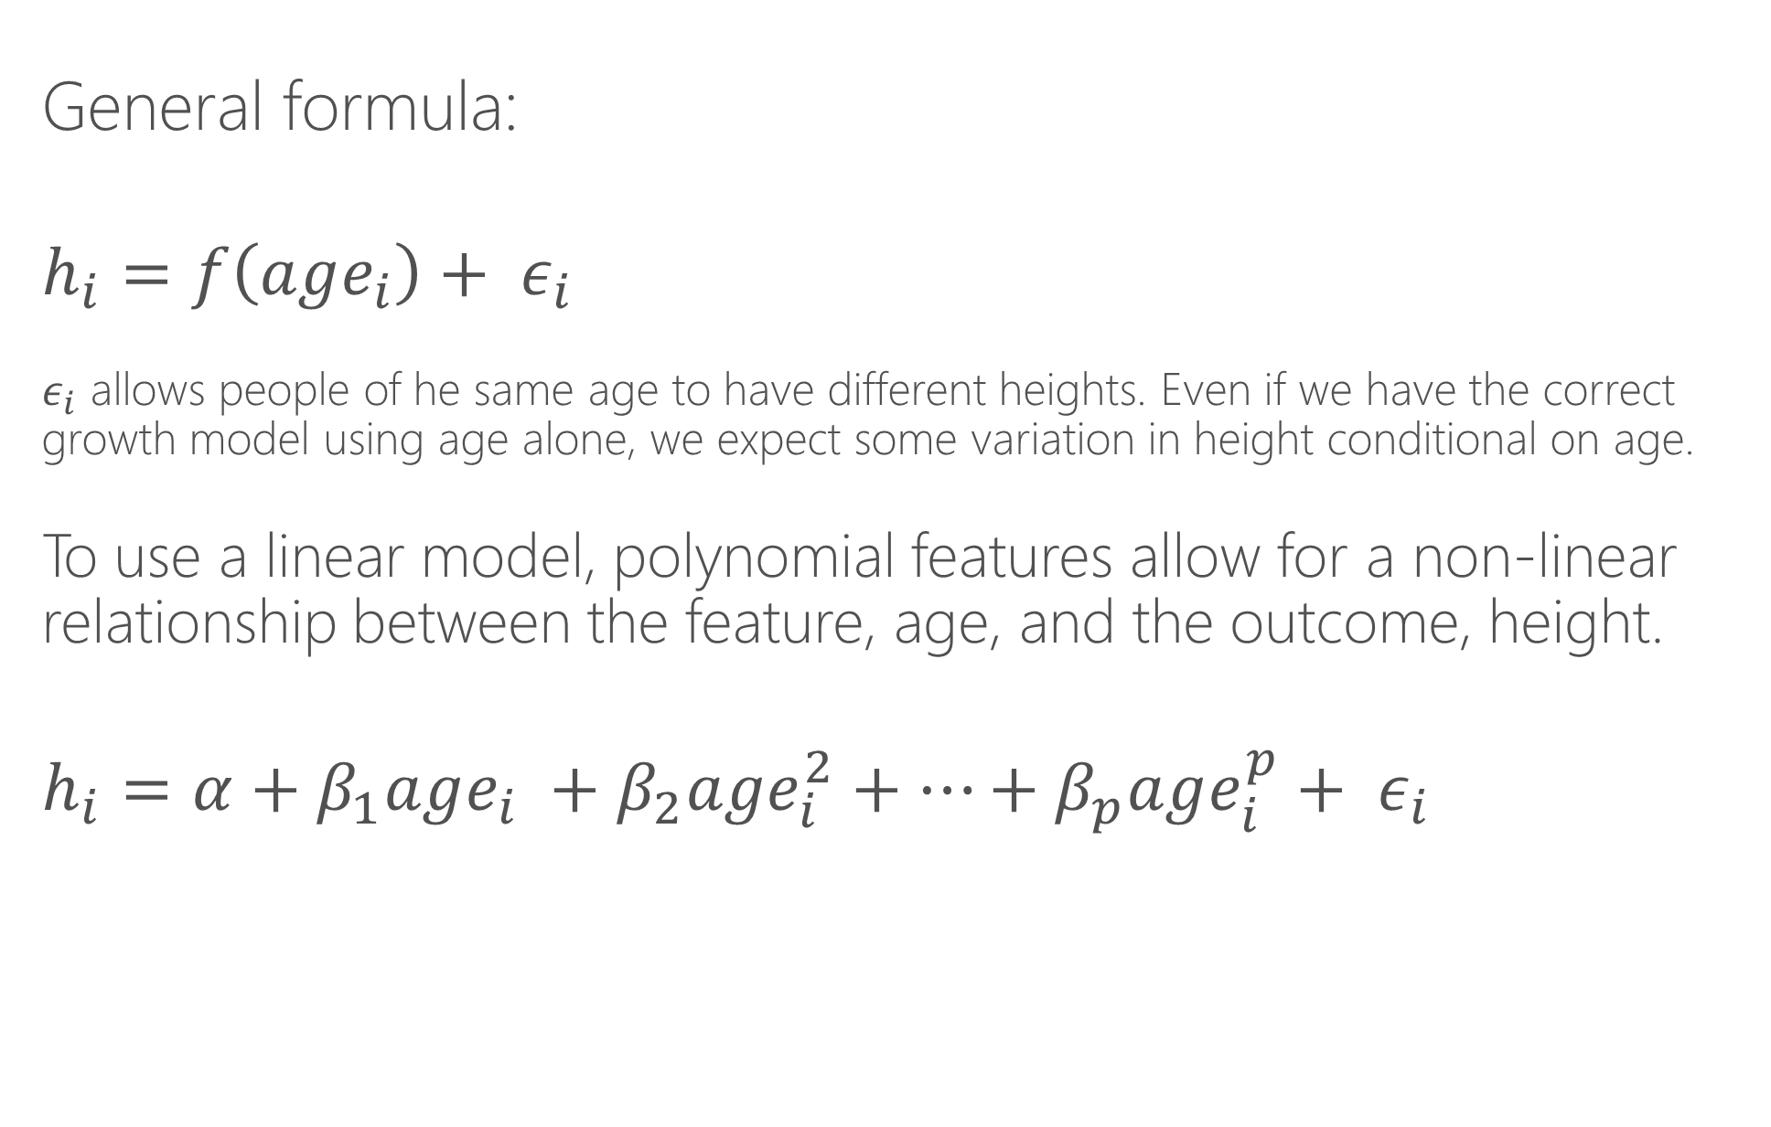
How would we estimate this relationship?
General formula:
$$h_{i}=f\left(age_{i}\right)+ ε_{i}$$
$ε_{i}$ allows people of he same age to have different heights. Even if we have the correct growth model using age alone, we expect some variation in height conditional on age.
To use a linear model, polynomial features allow for a non-linear relationship between the feature, age, and the outcome, height.
$$h_{i}=α+β_{1}age_{i} +β_{2}age_{i}^{2}+…+β_{p}age_{i}^{p}+ ε_{i}$$

Slide 12
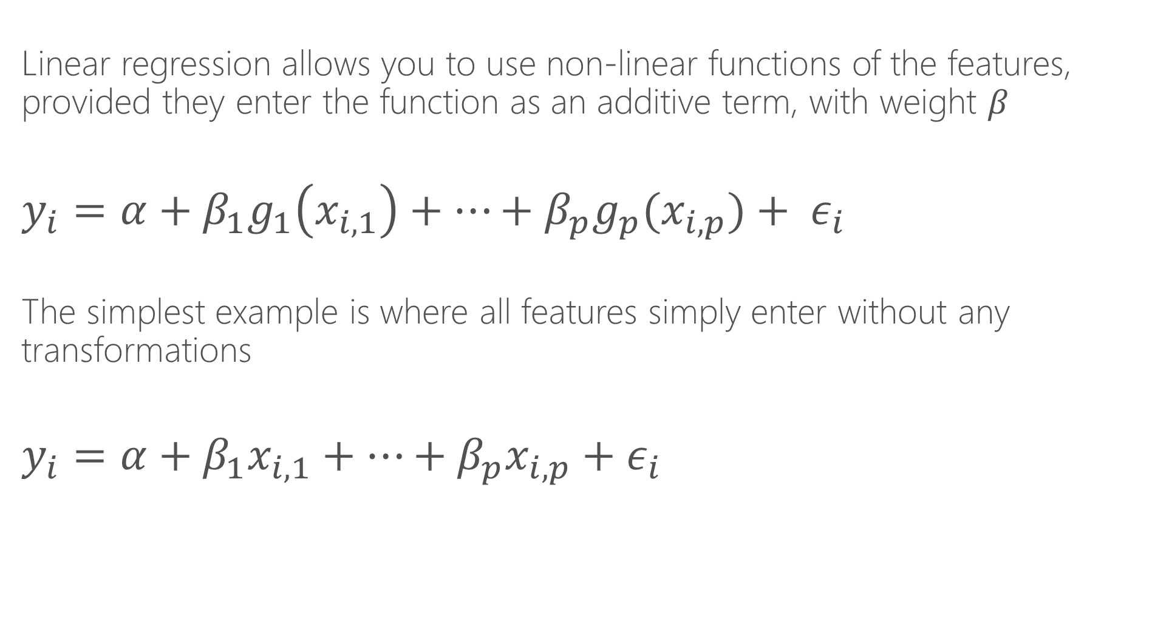
Linear regression
Linear regression allows you to use non-linear functions of the features, provided they enter the function as an additive term, with weight $β$
$$y_{i}=α+β_{1}g_{1}\left(x_{i,1}\right)+…+β_{p}g_{p}(x_{i,p})+ ε_{i}$$
The simplest example is where all features simply enter without any transformations
$$y_{i}=α+β_{1}x_{i,1}+…+β_{p}x_{i,p}{+ ε}_{i}$$

Slide 13
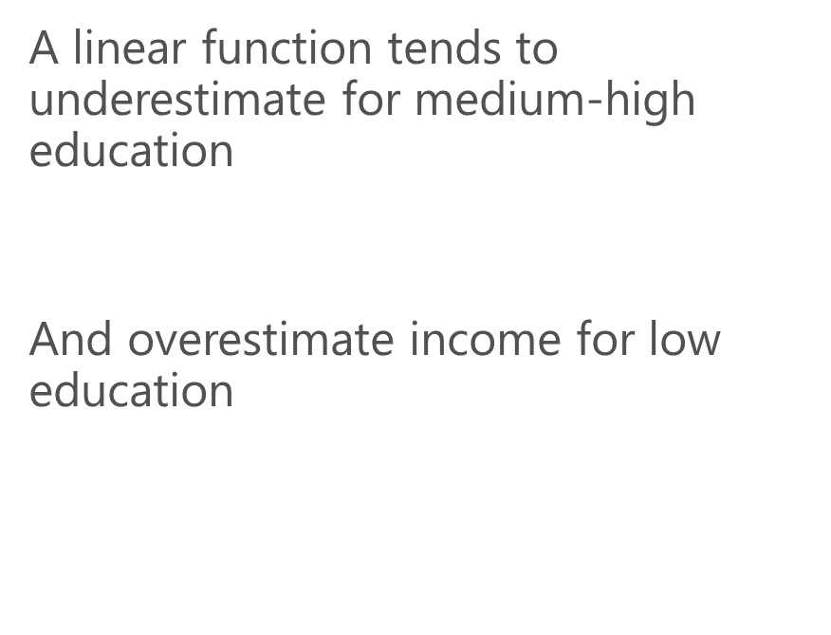
Linear regression
$$y_{i}=α+β_{1}x_{i}{+ ε}_{i}$$
A linear function tends to underestimate for medium-high education
And overestimate income for low education

Slide 14
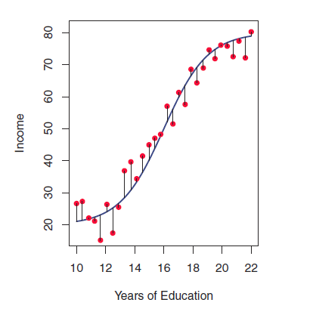
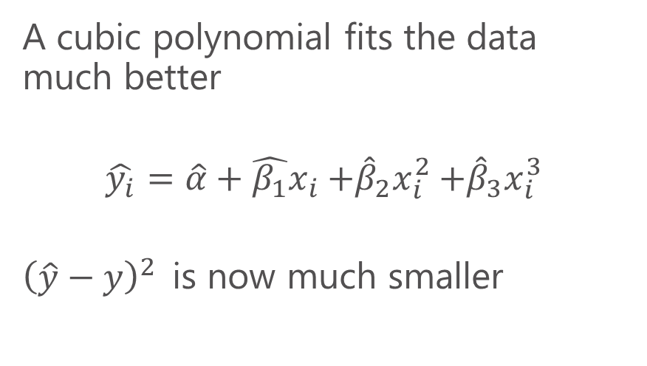
Linear regression
A cubic polynomial fits the data much better
$$\hat{y_{i}}=\hat{α}+{\hat{β_{1}}x}_{i}{+{\hat{β}}_{2}x}_{i}^{2}+{{\hat{β}}_{3}x}_{i}^{3}$$
${\left(\hat{y}−y\right)}^{2}$is now much smaller

Slide 15
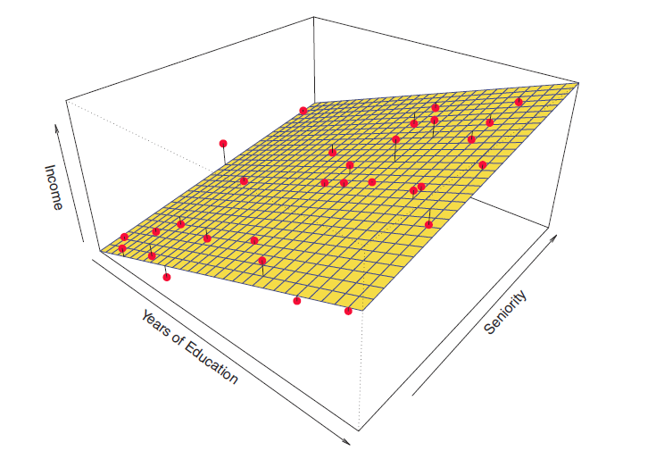
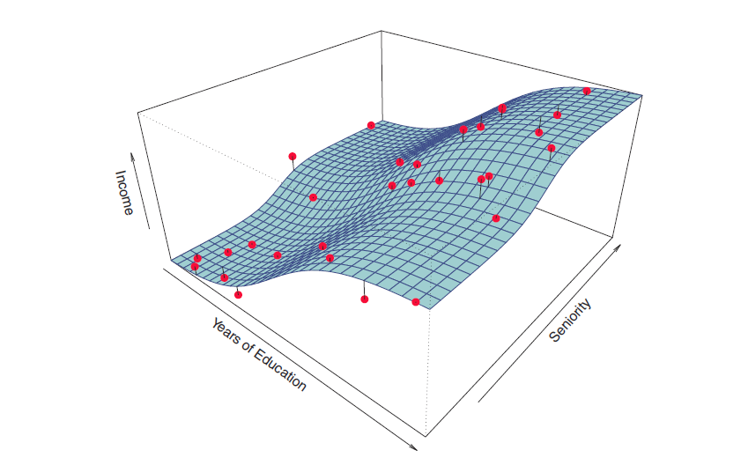
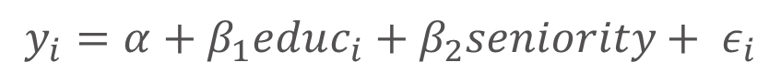
Visualizing in two dimensions
Higher order polynomial in educ and seniority could approximate this function
$$y_{i}=α+β_{1}educ_{i}{+ β_{2}seniority+ ε}_{i}$$

Slide 16
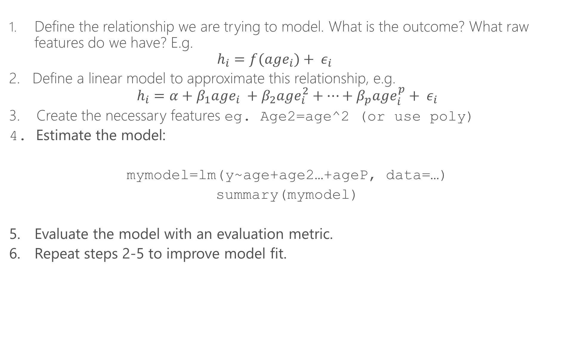
Steps for linear regression
Define the relationship we are trying to model. What is the outcome? What raw features do we have? E.g.
$$h_{i}=f(age_{i})+ ε_{i}$$
2. Define a linear model to approximate this relationship, e.g.
$$h_{i}=α+β_{1}age_{i} +β_{2}age_{i}^{2}+…+β_{p}age_{i}^{p}+ ε_{i}$$
3. Create the necessary features eg. Age2=age^2 (or use poly)
4. Estimate the model:
mymodel=lm(y~age+age2…+ageP, data=…)
summary(mymodel)
5. Evaluate the model with an evaluation metric.
6. Repeat steps 2-5 to improve model fit.

Slide 17
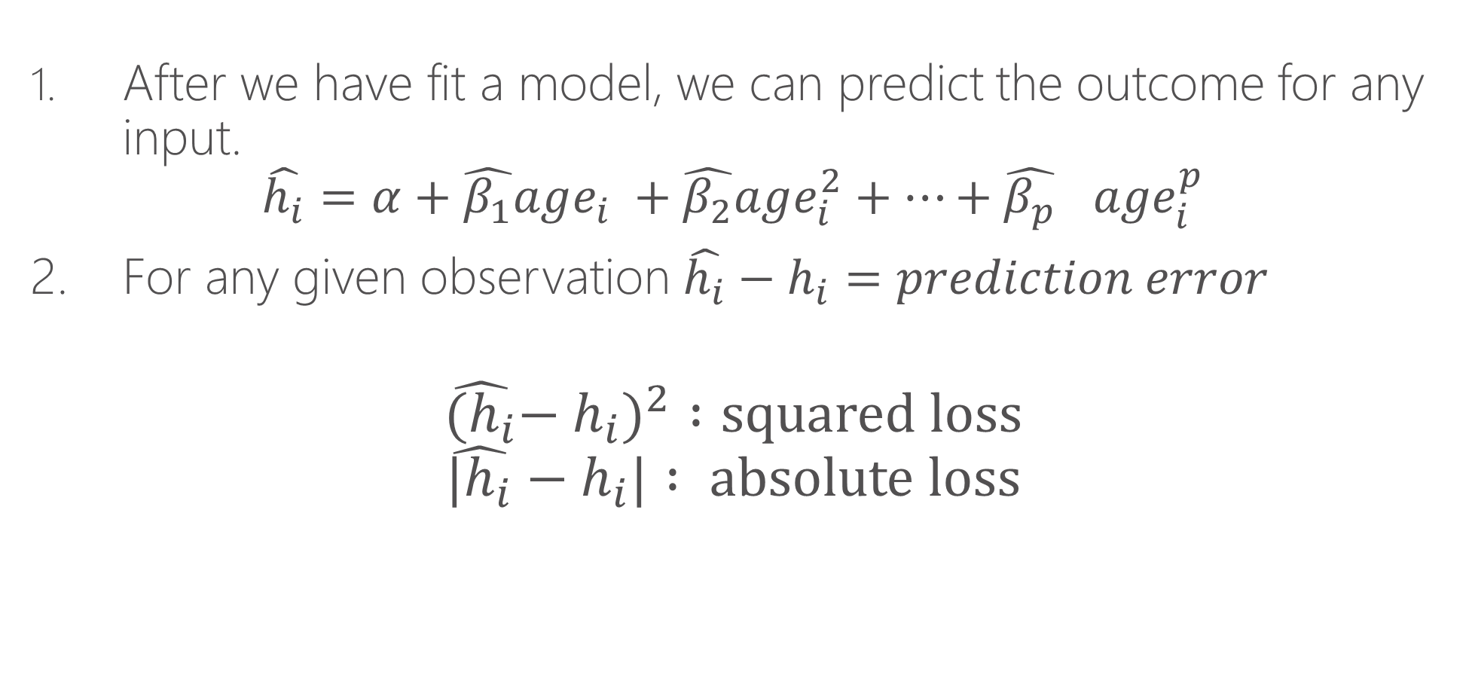
Model prediction
After we have fit a model, we can predict the outcome for any input.
$$\hat{h_{i}}=α+\hat{β_{1}}age_{i} +\hat{β_{2}}age_{i}^{2}+…+{\hat{β_{p}}}_{}age_{i}^{p}$$
2. For any given observation $\hat{h_{i}}−h_{i}=prediction error$
$${\hat{{(h}_{i}}−h_{i})}^{2} :squared loss$$
$$\hat{{|h}_{i}}−h_{i}| : absolute loss$$

Slide 18
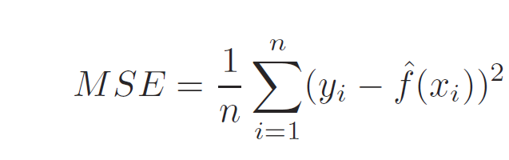
Model Fit
Fit refers to how well our model, an approximation of reality, matches what we actually observe in the data
Mean squared error is the average of squared loss for each data point (row) we evaluate

Slide 19
Training vs. Test
We typically want to “train” the model on the data “we have” and test the model on “new data”
This is a realistic test of how well the model predicts outcomes.
In practice, we will subset our data:
X%: Training
Y%: Test
80% is commonly used for training.

Slide 20
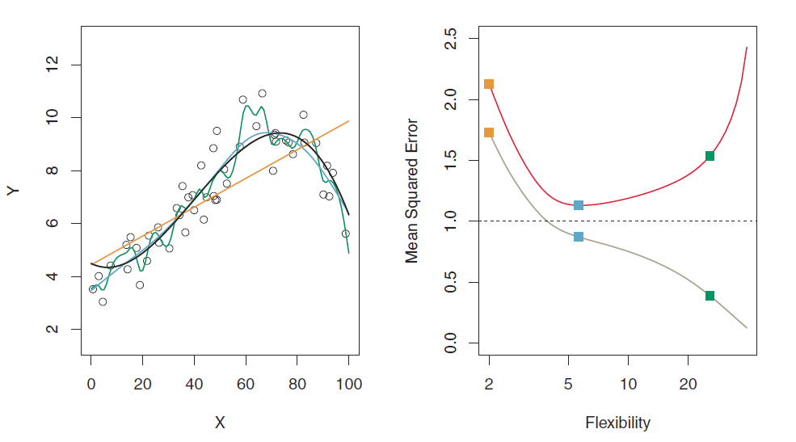
Why do we need training vs. test?
MSE: test set
MSE: training set

Slide 21
Why do we need training vs. test?
The green curve “overfits” the data. It fits the noise.
Using a “out of sample” test set guards against “overfitting”
The blue curve gets closest to the black (truth) curve

Slide 22
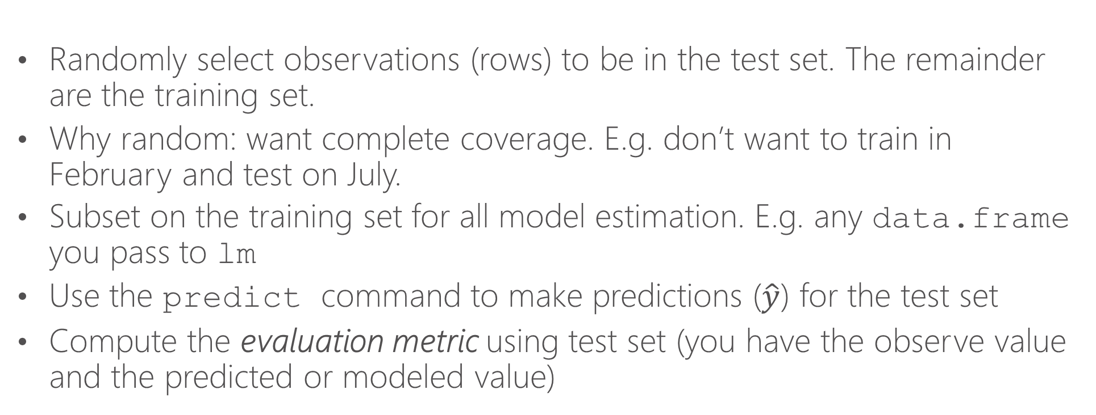
Training vs. test in practice
Randomly select observations (rows) to be in the test set. The remainder are the training set.
Why random: want complete coverage. E.g. don’t want to train in February and test on July.
Subset on the training set for all model estimation. E.g. any data.frame you pass to lm
Use the predict command to make predictions ($\hat{y}$) for the test set
Compute the evaluation metric using test set (you have the observe value and the predicted or modeled value)

Slide 23
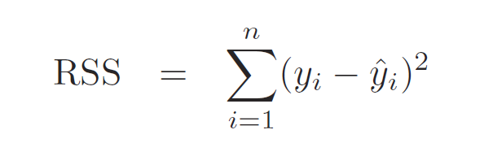
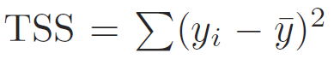
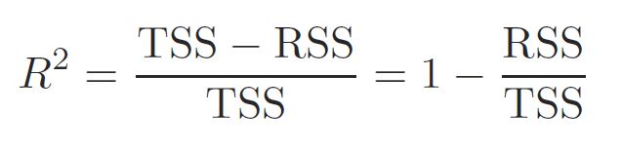
R-squared
Residual sum of squares
Total variation in outcome variable (ȳ is the sample mean)
Fraction of the variation in the outcome variable captured by the model
(when you minimize the total sum of the squares, you get an R-squared closer to 1)

Slide 24
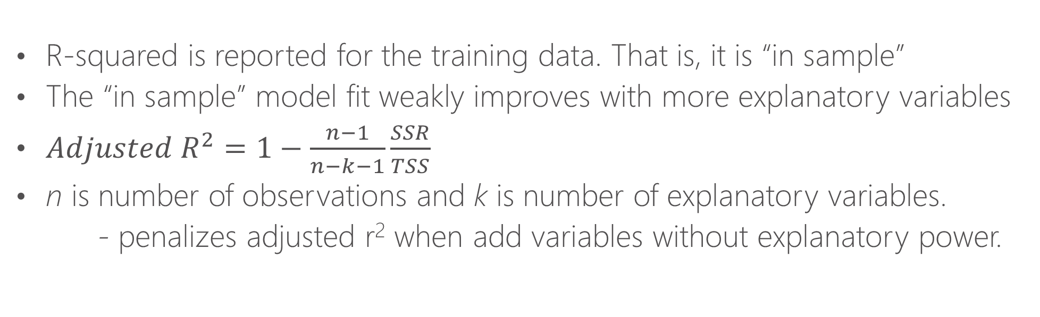
Adjusted R-squared
R-squared is reported for the training data. That is, it is “in sample”
The “in sample” model fit weakly improves with more explanatory variables
$Adjusted R^{2}=1−\frac{n−1}{n−k−1}\frac{SSR}{TSS}$
n is number of observations and k is number of explanatory variables.
- penalizes adjusted r² when add variables without explanatory power.

Slide 25
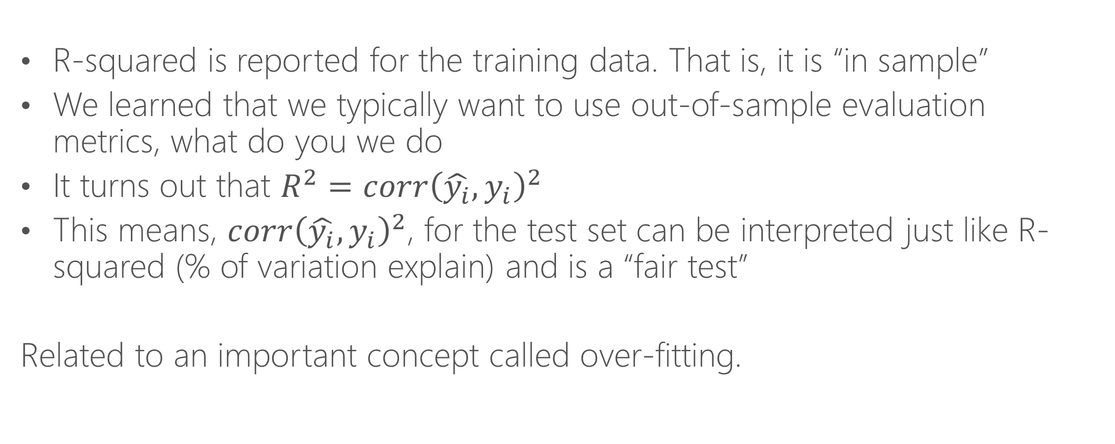
A “Fair” R-squared Measure
R-squared is reported for the training data. That is, it is “in sample”
We learned that we typically want to use out-of-sample evaluation metrics, what do you we do
It turns out that $R^{2}=corr{\left(\hat{y_{i}},y_{i}\right)}^{2}$
This means, $corr{\left(\hat{y_{i}},y_{i}\right)}^{2}$, for the test set can be interpreted just like R-squared (% of variation explain) and is a “fair test”
Related to an important concept called over-fitting.

Slide 26
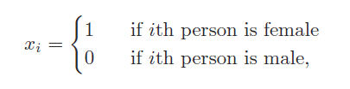
Feature types
Binary features: equal to 1 or 0. For example:
Continuous features: can take an real value
Categorical features: can take one of N values. E.g. Saturday, Sunday, Monday… declaring as.factor then R will treat it as N binary variables for each category (ex. =1 if Saturday, =0 otherwise)

Slide 27
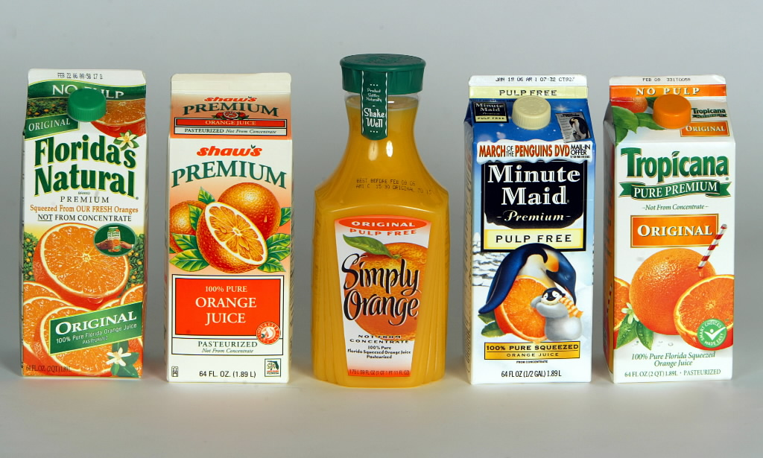

Running Example: Orange Juice
Data: 83 Chicago-area stores
At weekly level:
Sales (“log move”)
Average sales price
Whether advertised (“feat”)
At store level:
Various demographics of the shoppers
Data taken from:
“Determinants of Store-Level Price Elasticity” Stephen J. Hoch, Byung-Do Kim, Alan L. Montgomery and Peter E. Rossi
Journal of Marketing Research Vol. 32, No. 1 (Feb., 1995), pp. 17-29

Slide 28
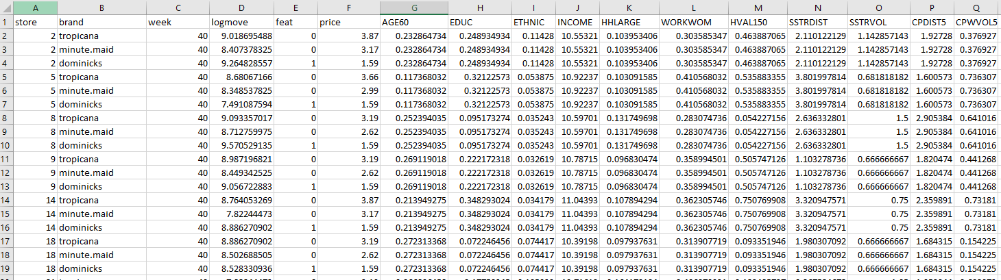
Data
Log of quantity sold each week
Price is not logged
Demographics of shoppers by store
We’ll study 3 brands, “dominicks” is the store’s brand
1 if advertised that week by that store, 0 if not

Slide 29
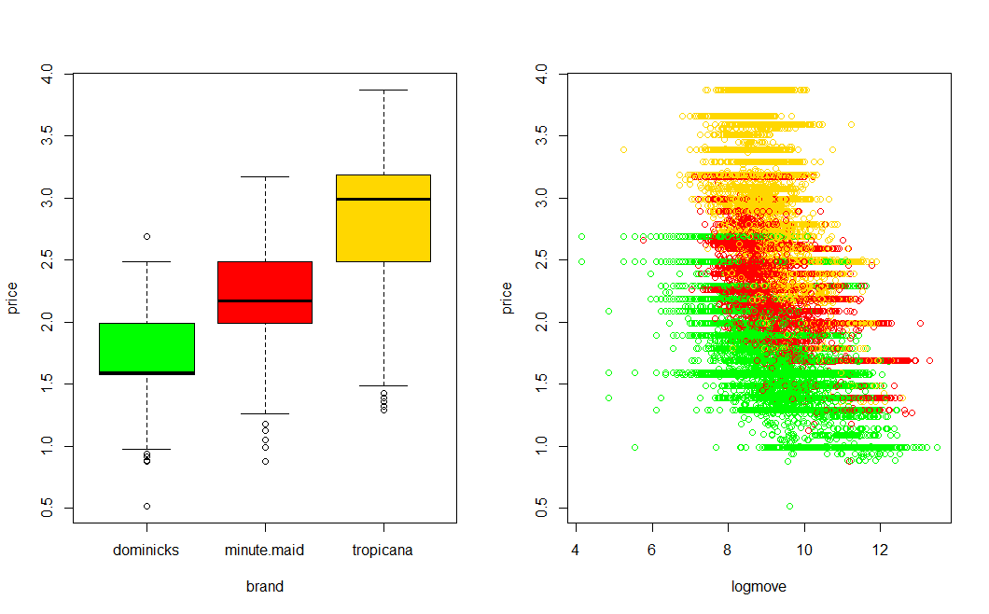

Slide 30
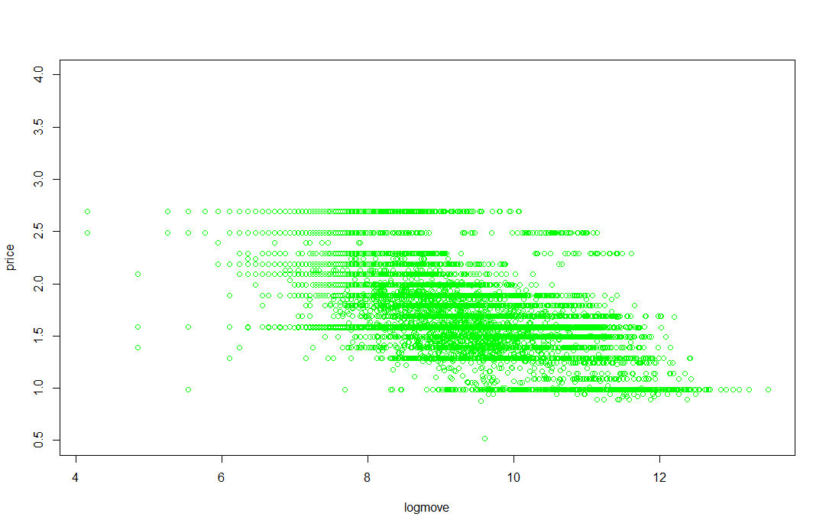
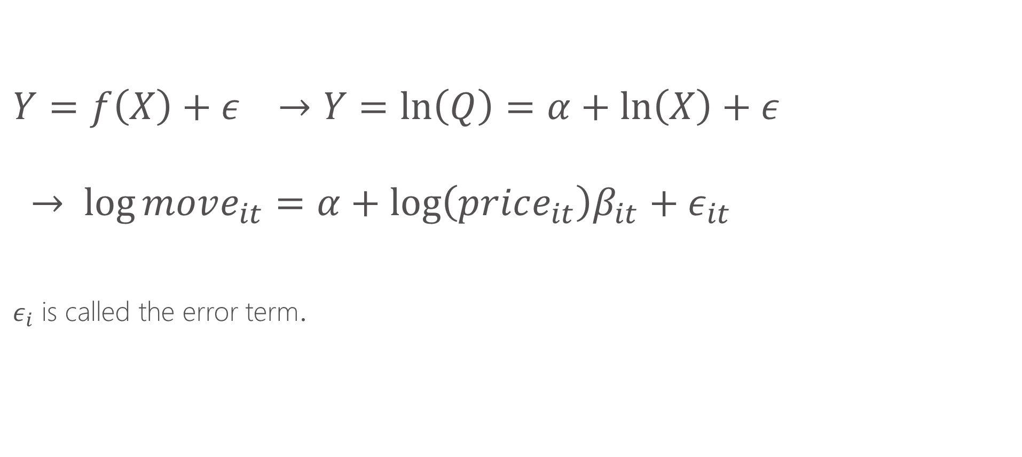
Estimating equations
$$Y=f\left(X\right)+ε →Y=\ln\left(Q\right)=α+\ln\left(X\right)+ε$$
$$→ \log{move_{it}=α+\log\left(price_{it}\right)β_{it}+ε_{it}}$$
$ε_{i}$ is called the error term.

Slide 31
Interpretation of Coefficients

Slide 32
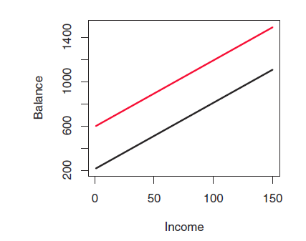
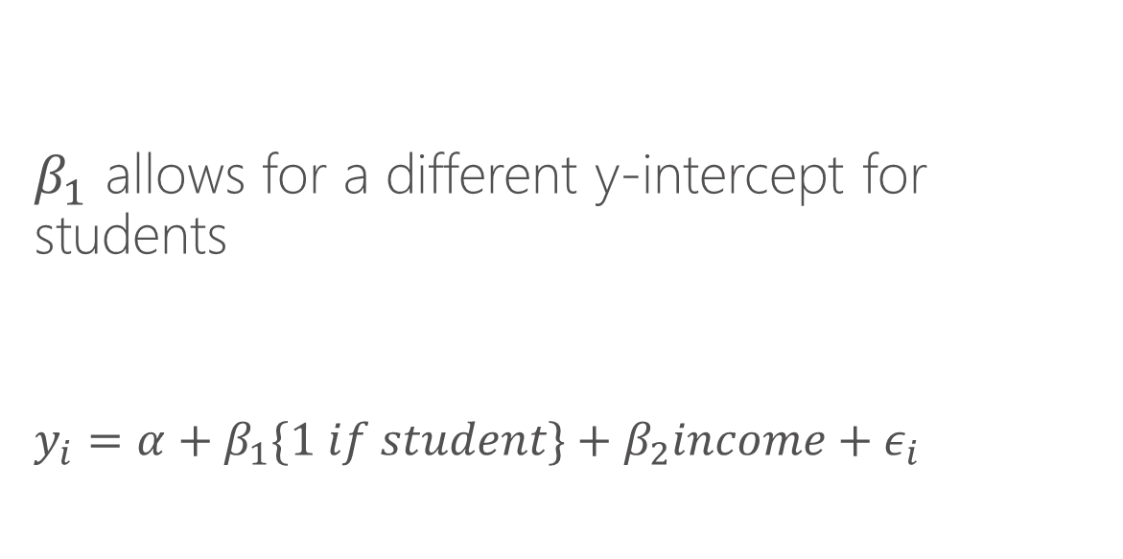
Understand binary features
$β_{1}$ allows for a different y-intercept for students
$$y_{i}=α+β_{1}\{1 if student\}+β_{2}income+ε_{i}$$

Slide 33
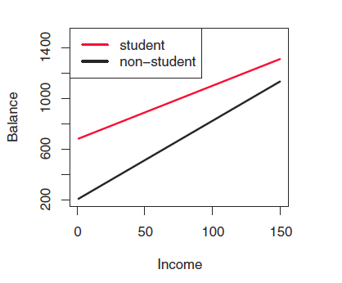
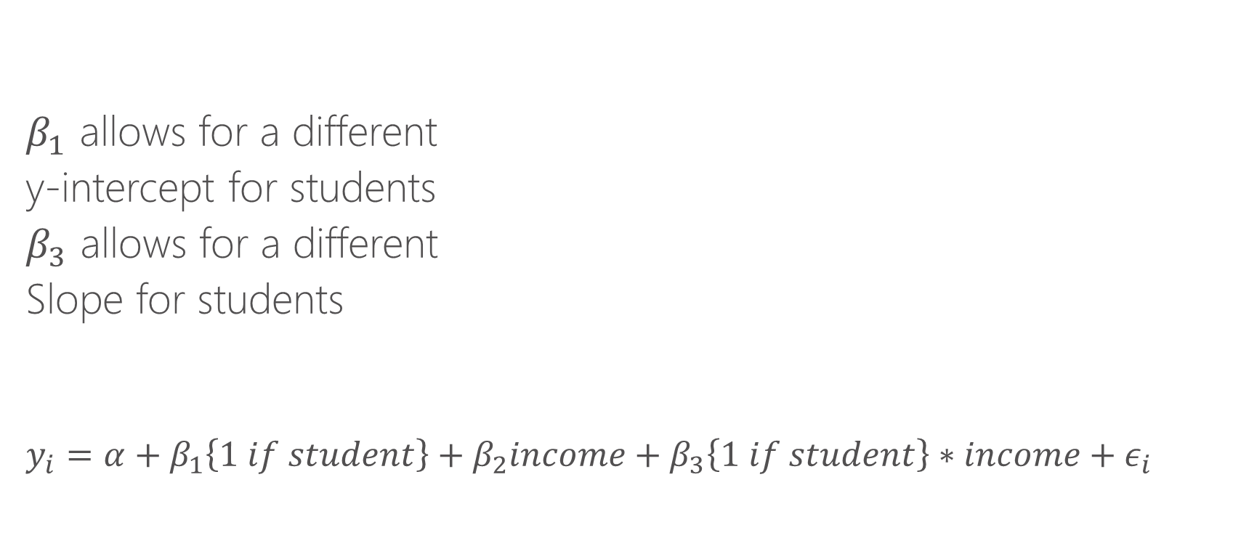
Understand binary features
$β_{1}$ allows for a different
y-intercept for students
$β_{3}$ allows for a different
Slope for students
$$y_{i}=α+β_{1}\left\{1 if student\right\}+β_{2}income+β_{3}\left\{1 if student\right\}∗income+ε_{i}$$

Slide 34
Interaction terms
Interaction term: multiplying two features by each other. When done as such:
{continuous feature}*{binary feature}
it allows for a different slope for the group represented by the binary feature. Note, be sure to include the continuous feature without the interaction as well.
Example, suppose temperature has a different impact on # of bikeshare trips taken on weekdays vs. weekends. We can create a binary variable is_weekend.
If we add is_weekend to the model, we allow for a different baseline ridership on weekends. If we add is_weekend*temp, we allow temperature to have a different effect for weekends.
We can “interact” is_weekend with a polynomial in temp. This effectively gives us a new model for temperature for the weekends vs. weekdays

Slide 35
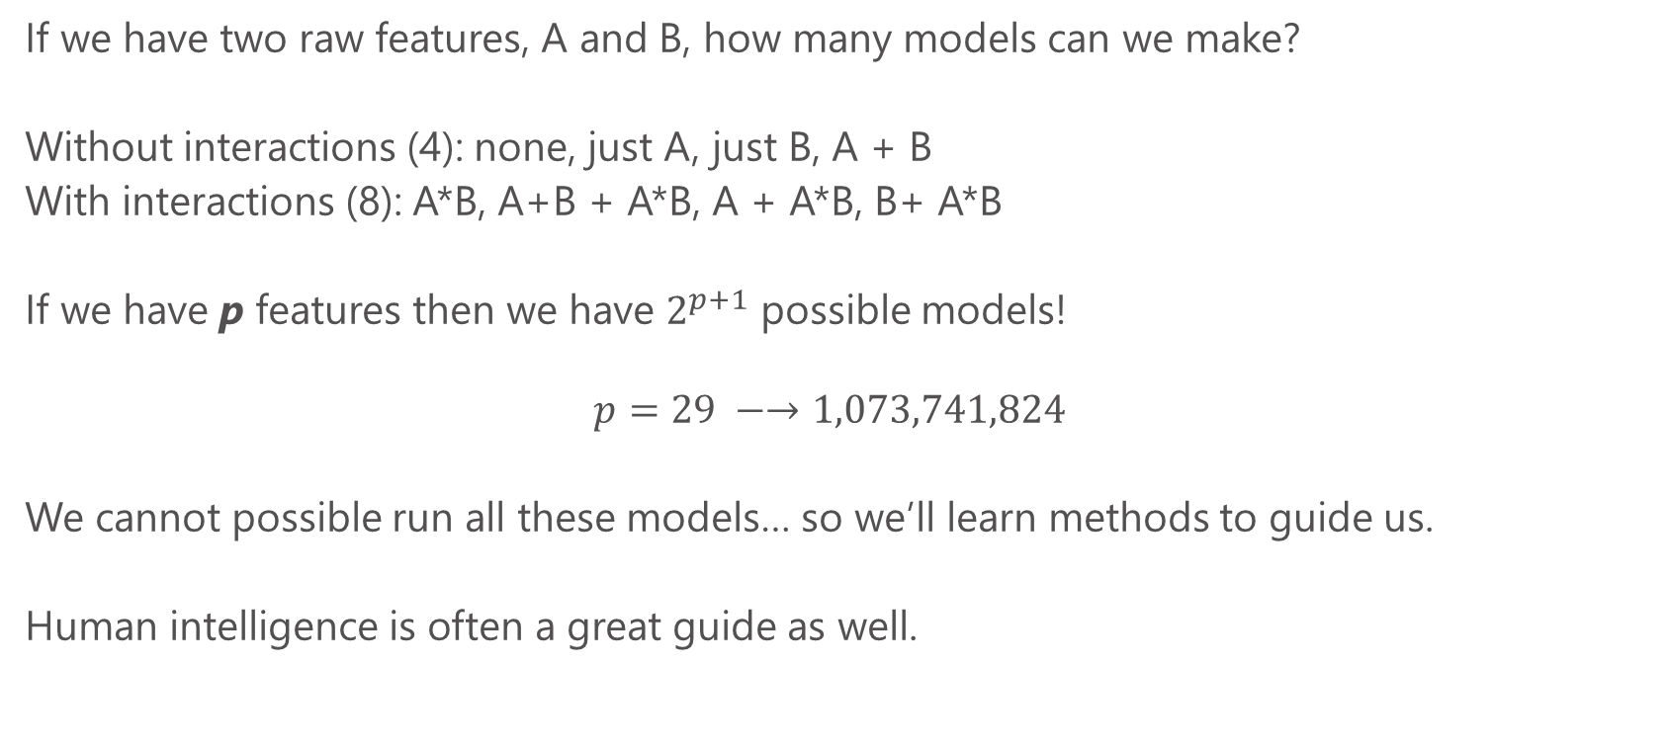
Feature explosion
If we have two raw features, A and B, how many models can we make?
Without interactions (4): none, just A, just B, A + B
With interactions (8): A*B, A+B + A*B, A + A*B, B+ A*B
If we have p features then we have $2^{p+1}$ possible models!
$$p=29 −→1,073,741,824$$
We cannot possible run all these models… so we’ll learn methods to guide us.
Human intelligence is often a great guide as well.

Slide 36
Interpreting regression output
Summary(my_model) gives the coefficient estimates (beta’s), t-statistics, standard errors and p-values.
t-statistics evaluate the hypothesis that the coefficient is equal to zero. Thus t greater than 1.96 in absolute value allows us to reject this hypothesis at the 95% level. P-values simply convert t-stats into the probability we would get something this far from zero due to sampling chance alone.
Note that t-statistics evaluate features “one by one”. Overall model fit is a better guide for explanatory power (e.g. we might be better for leaving insignificant features in sometimes)
t-stats can be a good guide to throw out irrelevant features

Slide 37
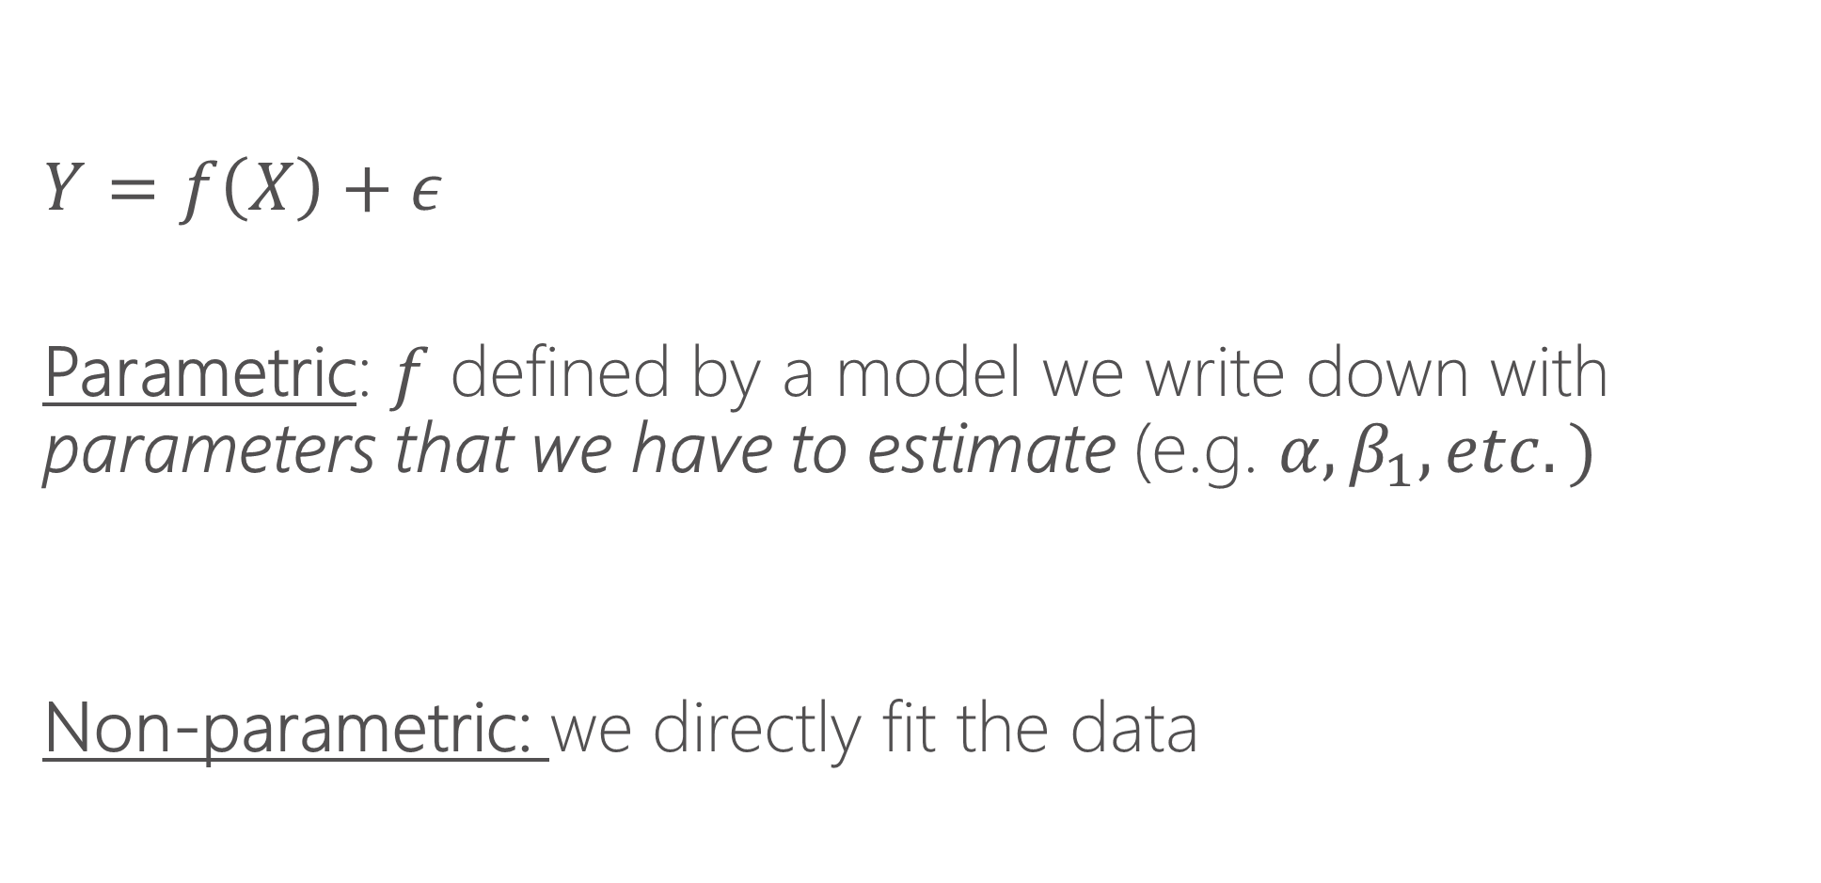
Parametric vs. non-parametric regression
$$Y=f\left(X\right)+ε$$
Parametric: $f$ defined by a model we write down with parameters that we have to estimate (e.g. $α, β_{1}, etc.)$
Non-parametric: we directly fit the data

Slide 38
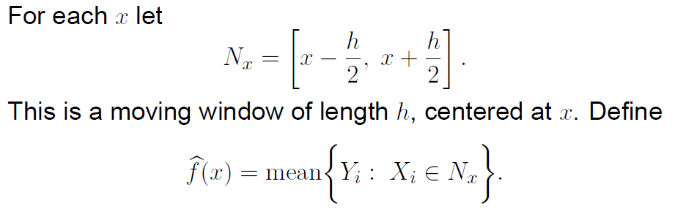
Local averaging

Slide 39
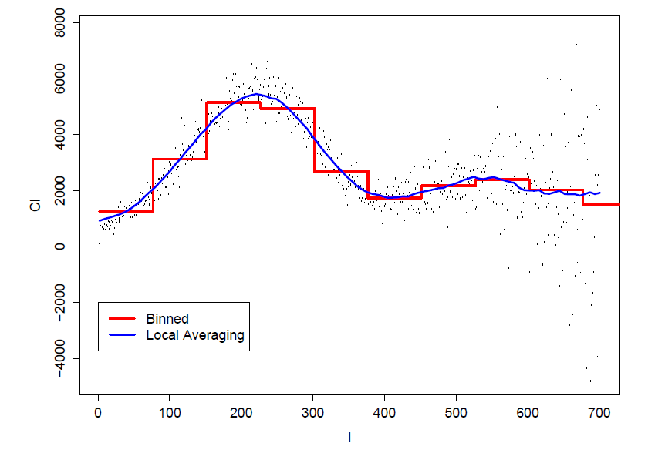
Local averaging vs. bins

Slide 40
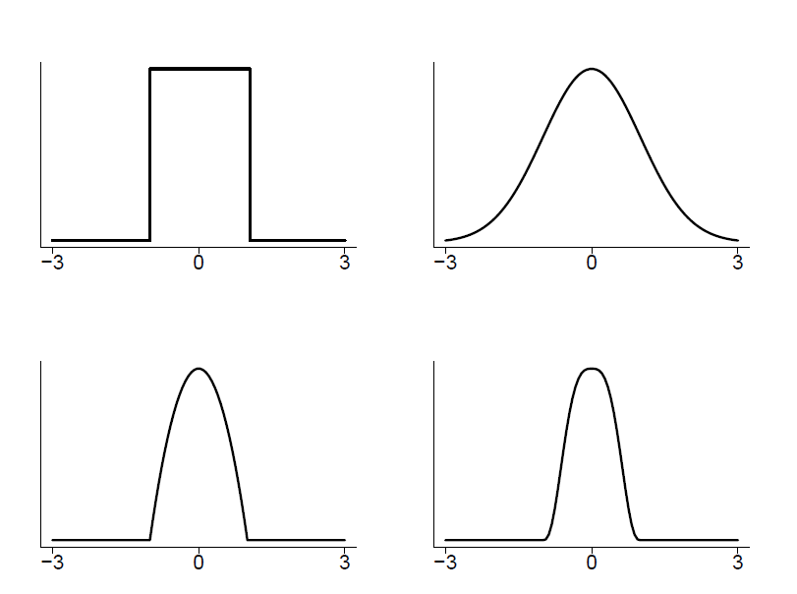
Kernels
A method of assigning higher weight to the points closer to the target point I am trying to fit.
Choice of kernel usually does not matter much.

Slide 41
Bandwidths
Bandwidths tell us how wide to make our kernel (window)
Larger bandwidths → smoother functions because there is more data used to make the averages
Bandwidth is sometimes called the smoothing parameter.
Bandwidths matter!

Slide 42
K-nearest neighbors
An alternative to bandwidths is instead of specifying a fixed window, we can say “use the nearest K nearest neighbors”
This ensures each bin has the same amount of data and can be a useful tool
Functionally it will often be quite similar to using a bandwidth, except when there are “sparse data” issues (then K-NNN is preferred)
Often expressed as a fraction of data. E.g. NN=.1 says “each bin is 10% of data”

Slide 43
Local polynomial regression
Thing of local averaging as fitting a constant for a given window of data
Instead of fitting a constant, we can fit a line (y=a*x + b) or a polynomial (y=a*x + b*x^2 + c), etc.
It is thus more general than local averaging, but very similar

Slide 44
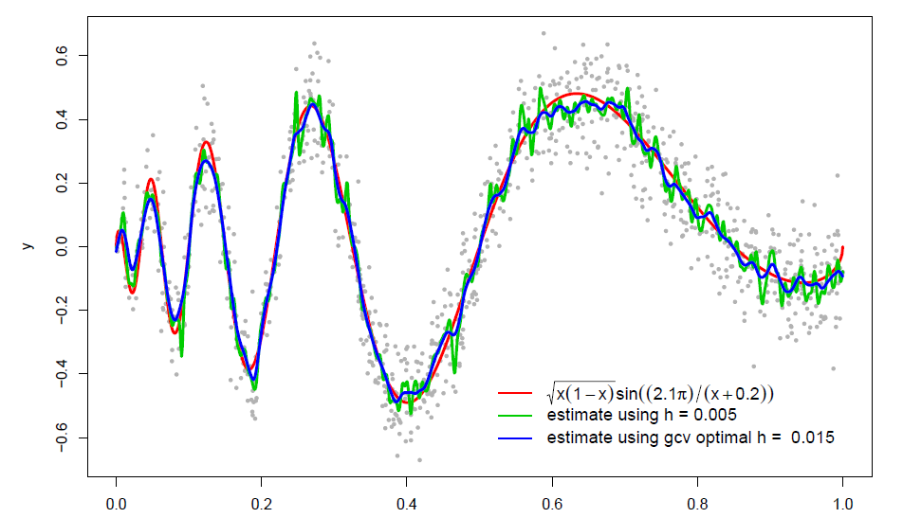
Some examples

Slide 45

Some examples

Slide 46
Local polynomial in R locfit install.packages(locfit) library(locfit) Modeler needs to specify: bandwidth (or fraction of nearest neighbors), degree of the local polynomial Contrast: in parametric regression, we had to write down a model Aside: we’ll learn that non-parametric methods struggle in higher dimensions

Slide 47
When to use each model?
If there are a relatively small number of features (e.g. <4) then non-parametric makes a lot of sense.
With many features, the “curse of dimensionality” sets in and non-parametric methods fall apart (the “neighborhood” is generally empty)
Parametric models using interaction terms and polynomials are the preferred method with many features
“Semi-parametric” methods combine elements of both

